Slide 1
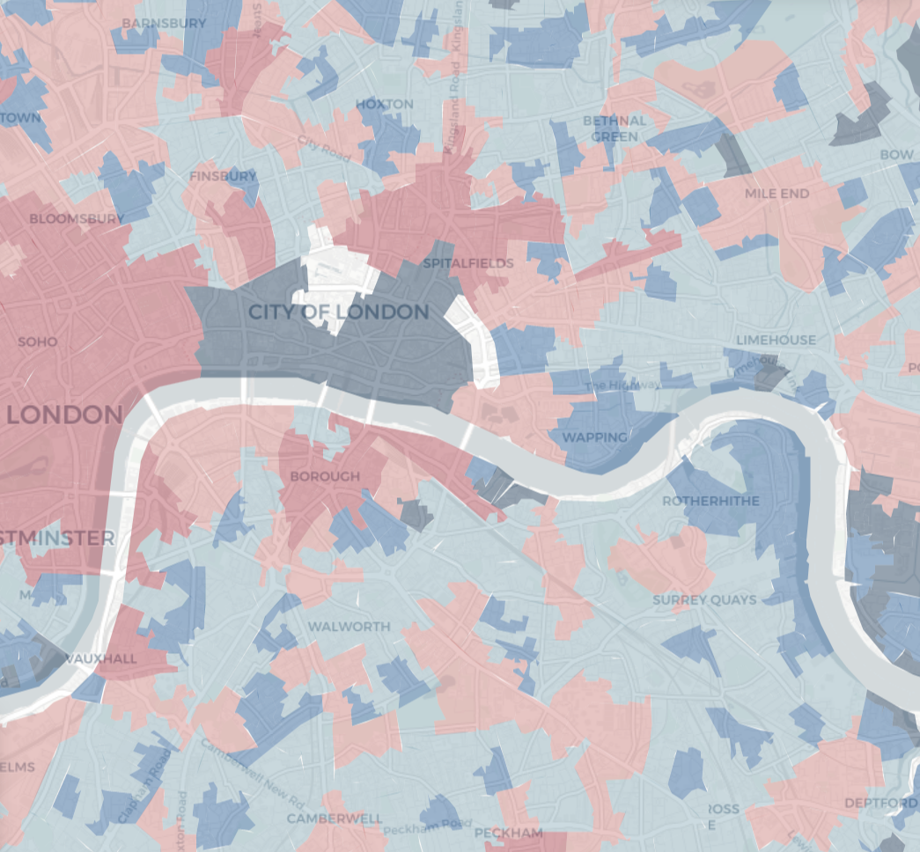
Wrattler
A framework for AI-assisted data wrangling
Final Report (Turing/GD006/1.2)
Tomas Petricek (PI), May Yong, Nick Barlow, Roly Perera, Anna Hadjitofi, Radka Jersakova

Slide 2
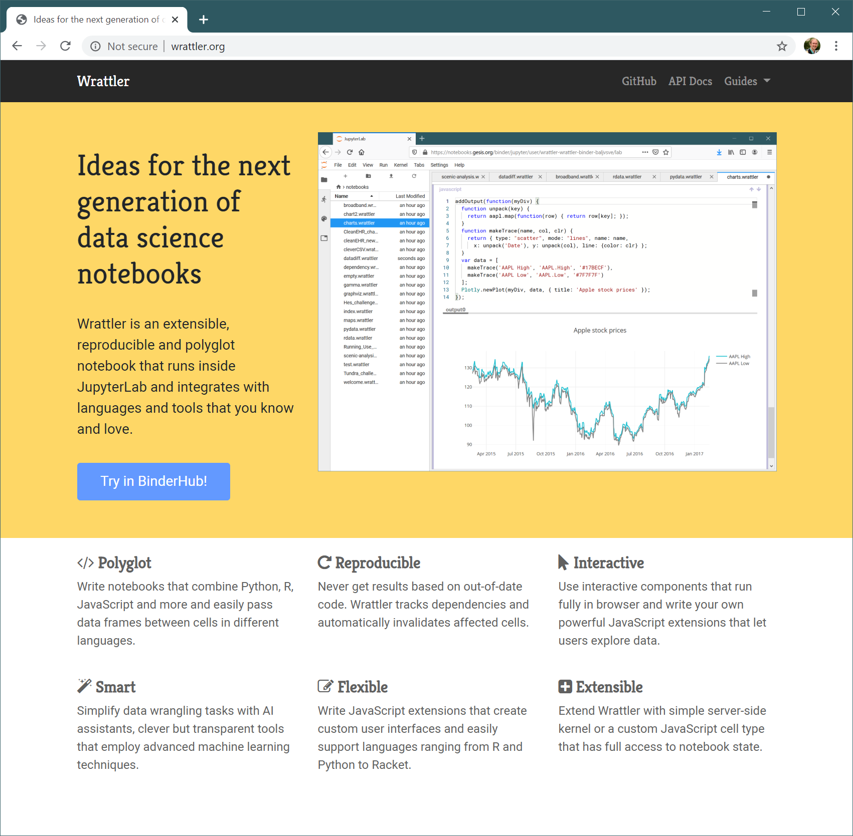
Wrattler: An AI-assisted framework for data wrangling
This report provides a brief overview of the work done on the Wrattler data wrangling platform as part of the project Turing/GD006/1.2 between April 2019 and March 2020. The work on Wrattler has been divided into the following two strands:
Working with the Turing community on implementing concrete case studies in Wrattler and using this to guide the development
Implement innovative notebook features that leverage the Wrattler architecture and can significantly accelerate the data science workflow
We start with an overview of the work done before looking at selected individual aspects in more detail.

Slide 3
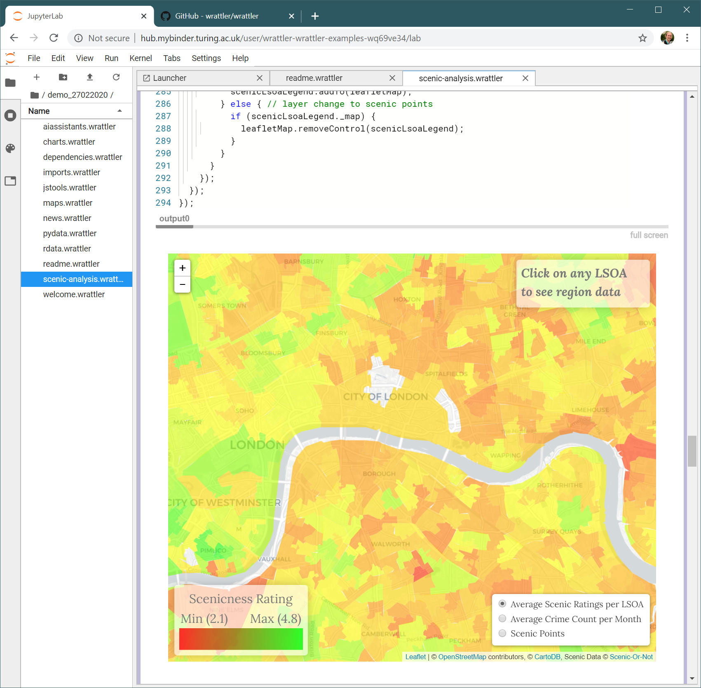
1. Turing case studies and core system development (1/2)
a. Identify and work on three case studies
We collaborated with the Turing community and Turing data scientists used Wrattler for three projects:
Testing the Broken Window hypothesis (see fig.)
NLP analysis of Turing publications
Detecting patterns in neonatal intensive care
b. Improve the ability to handle large data frames
Wrattler data store now uses Apache Arrow to store and transmit data in an efficient binary format. This makes it possible to work with larger files (100MB – 1GB). Due to the lack of concrete use cases, we have not investigated support for Spark, which would be the next logical step towards “Big Data” support in Wrattler.

Slide 4
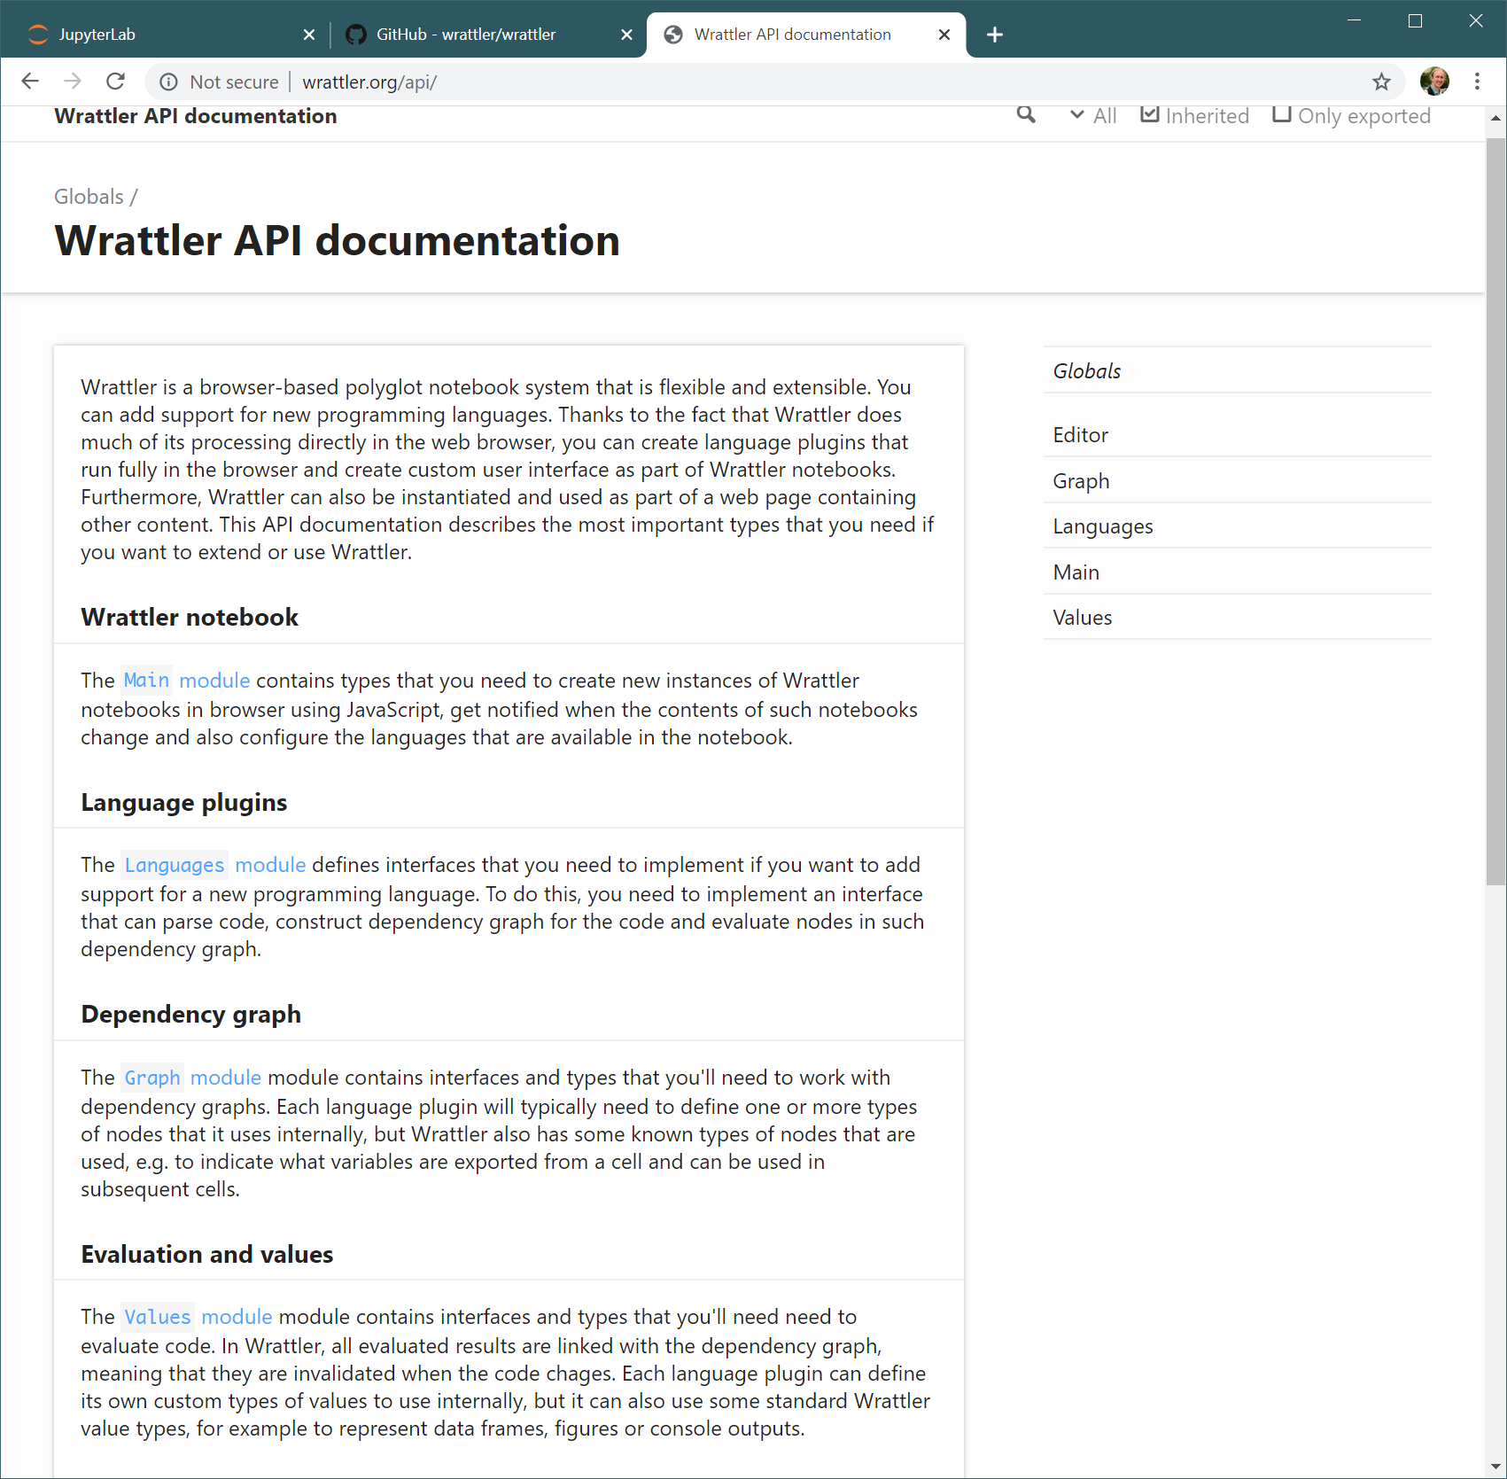
1. Turing case studies and core system development (2/2)
c. Integrate Wrattler into Jupyter Lab and/or Binder
Wrattler adds a new type of notebook to Jupyter Lab (figure on the previous slide). It can be hosted in the cloud using Binder, which lets anyone try it using the “Try in Binder” button on the homepage.
d. Document the public interface of Wrattler
The Wrattler web page now hosts a comprehensive documentation (see figure). We also published a guide on “Creating language plugins” that has been used by a developer joining the team later.
e. Specification of imports, efficiency of previews
Imports are now specified via the standard Binder mechanism and previews no longer download the whole data set into the browser (only first N rows).

Slide 5
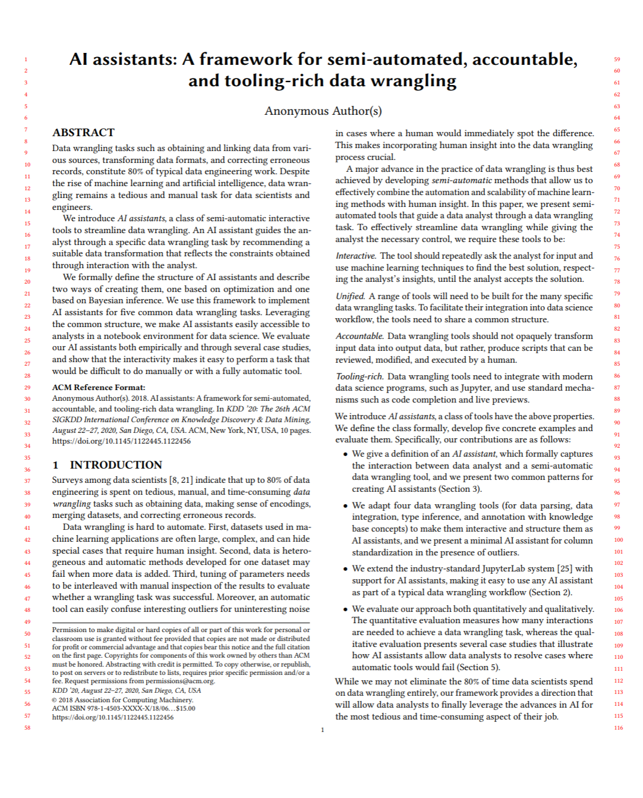
2. Implementing innovative notebook features (1/2)
We explored the feasibility of the following features and implemented four (two more than expected):
a. Integration of AI assistants developed by AIDA
We implemented support for interactive AI assistants as a new cell type with Wrattler. We integrated three AIDA assistants (datadiff, ptype and CleverCSV) as well as one new (Outlier detection). The ColNet assistants remains a prototype.
b. An API for the development of new AI assistants
The API is documented in the project repository in a readme file. A comprehensive report has been submitted as a paper to the KDD 2020 conference.

Slide 6
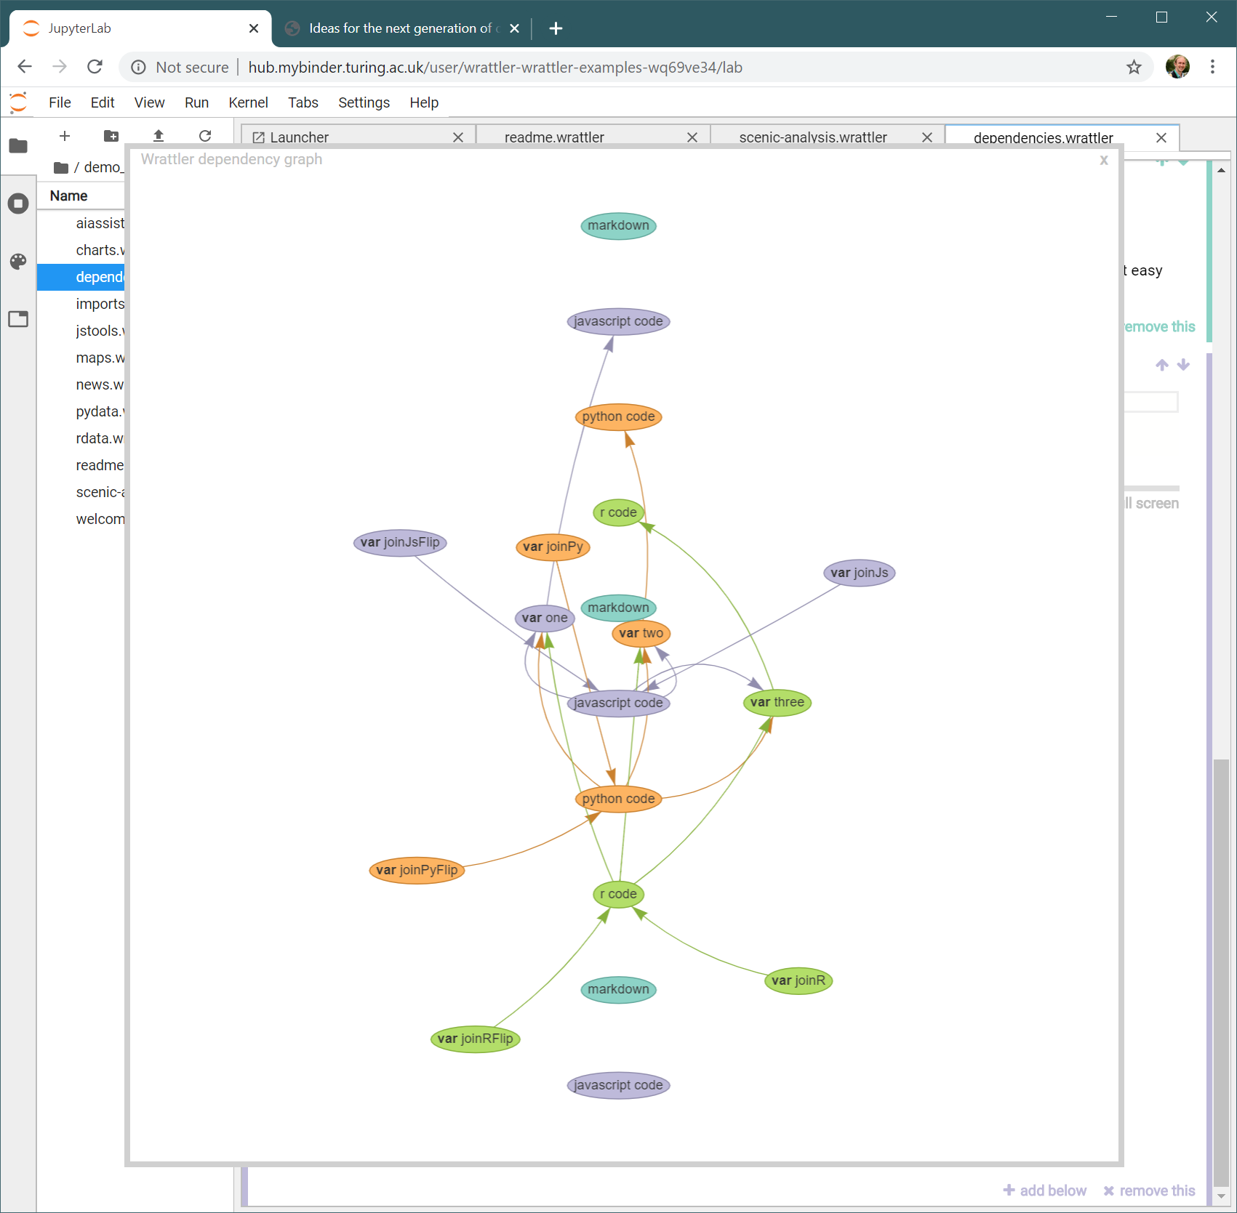
2. Implementing innovative notebook features (2/2)
c. Create refactoring tools
We completed preliminary work (making it possible to import functions from .py, .R and .js files), but did not focus on this area further.
d. Support interesting programming languages
We added support for a research language for building transparent data visualization that has been developed at the Turing – called project Fluid.
e. Better exposure of the dependency graph
The dependency graph is now exposed to the user who can access it programmatically. We used this feature to build a simple visualization tool (see figure), although deeper integration is an interesting future work.

Slide 7
Detailed overview of selected work done
In the rest of the report, we provide more details on some of the interesting aspects of the work.
We now look at the following components
Web page and documentation (1d)
Case studies using Wrattler (1a)
Integration with Binder and JupyterLab (1c)
Support for AI assistants (2a)
Data visualization language (2d)

Slide 8
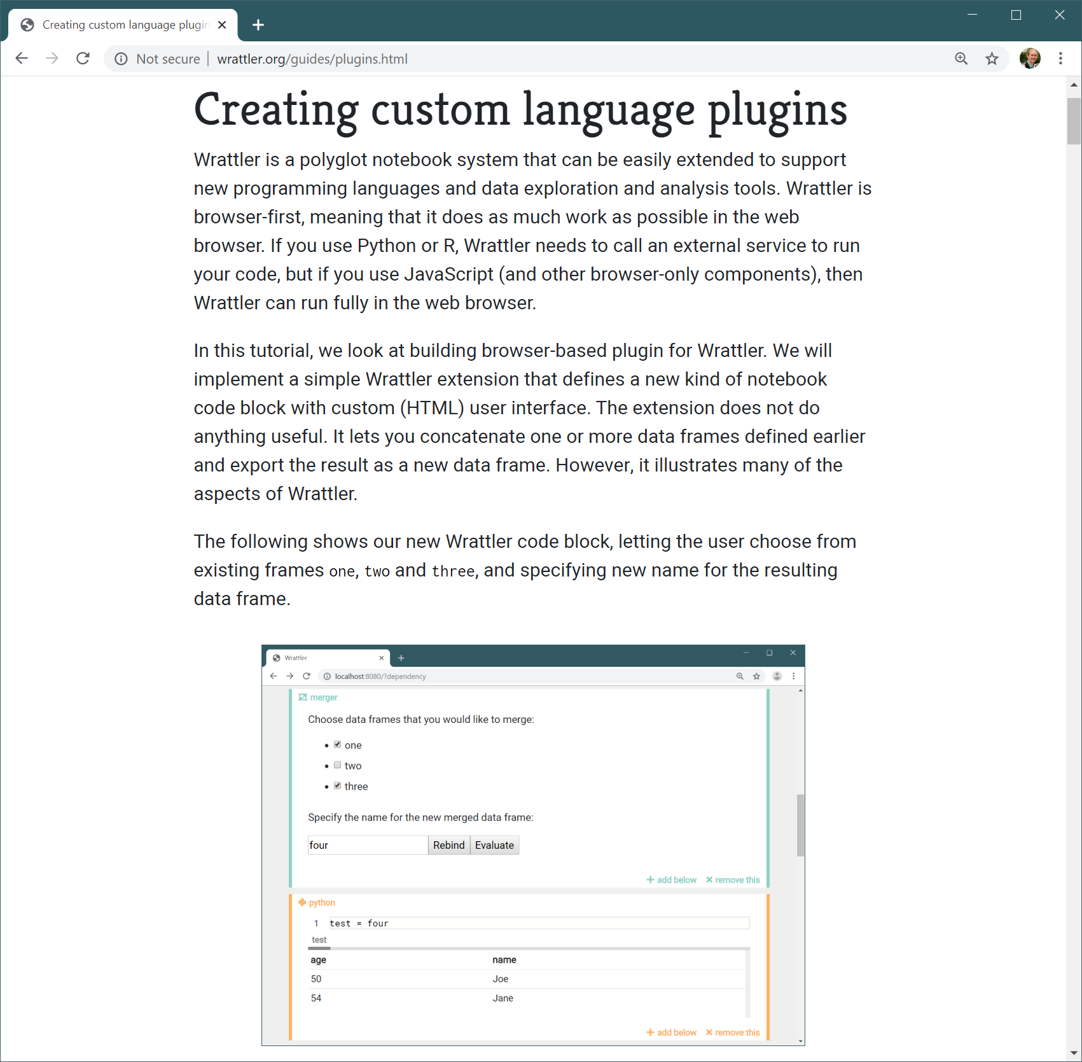
Launching Wrattler web page with documentation (1d)
Wrattler is open-source and is available under the permissive MIT license. To enable others to contribute, we launched three new resources:
http://wrattler.org is the new Wrattler homepage providing high-level project overview.
http://wrattler.org/guides/plugins.html documents how to build a custom language plugin
http://wrattler.org/api/ provides a detailed API documentation for Wrattler components
More information about developing and contributing to Wrattler can be found in our open-source repositories:
https://github.com/wrattler/wrattler
https://github.com/wrattler/wrattler-examples

Slide 9
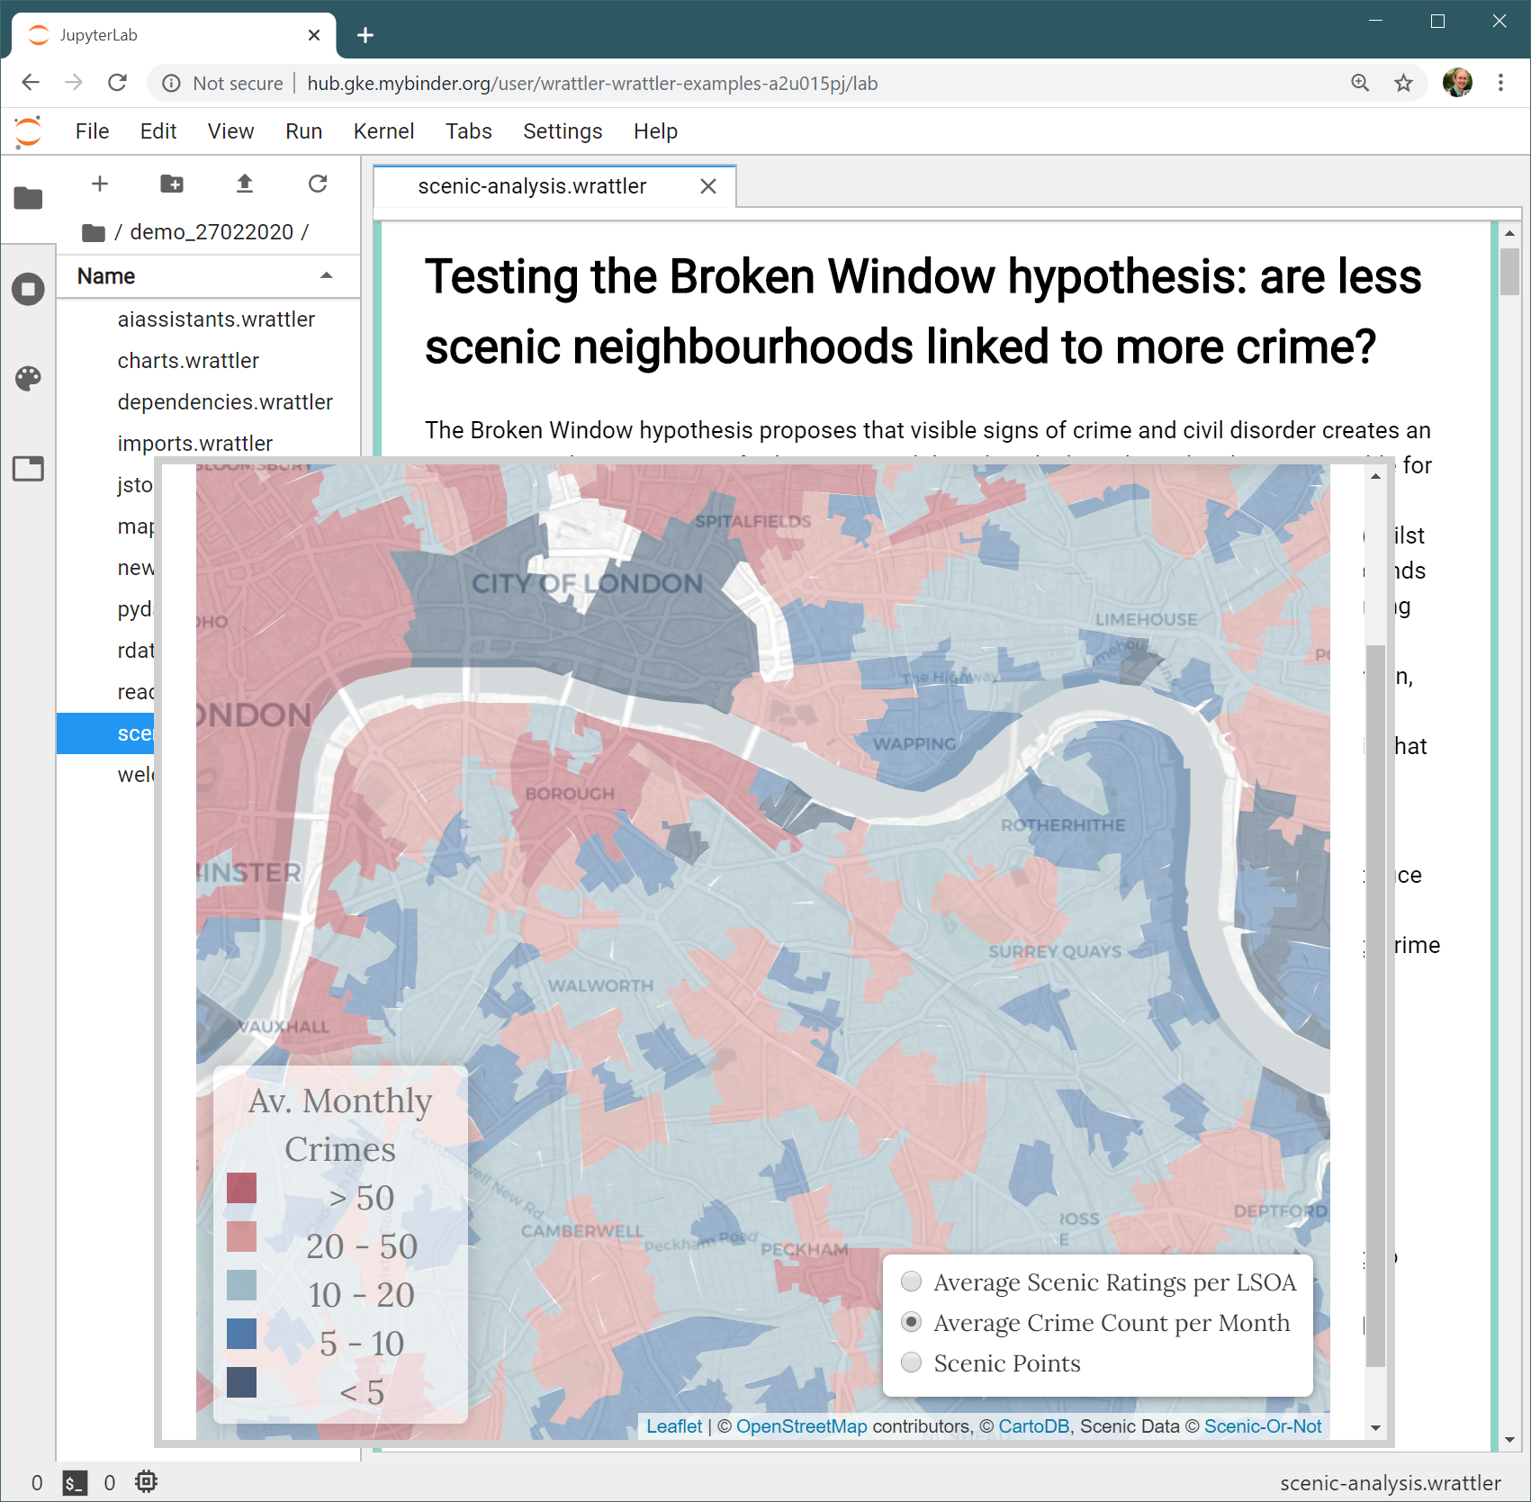
Case study I: Testing the Broken Window Hypothesis (1a)
The Broken Window hypothesis proposes that visible signs of crime and civil disorder create an environment that encourages further crime and disorder.
There are several technically interesting aspects:
The analysis combines multiple languages: Python for core analysis, R for statistical functions and JavaScript for data visualization.
The JavaScript code uses a third-party mapping library (Leaflet) to visualize geographical data.
This work has been done by Turing data scientist Anna Hadjitofi together with Chanuki Seresinhe, who is a visiting researcher at the Turing. The code is available from: https://github.com/wrattler/wrattler-examples

Slide 10
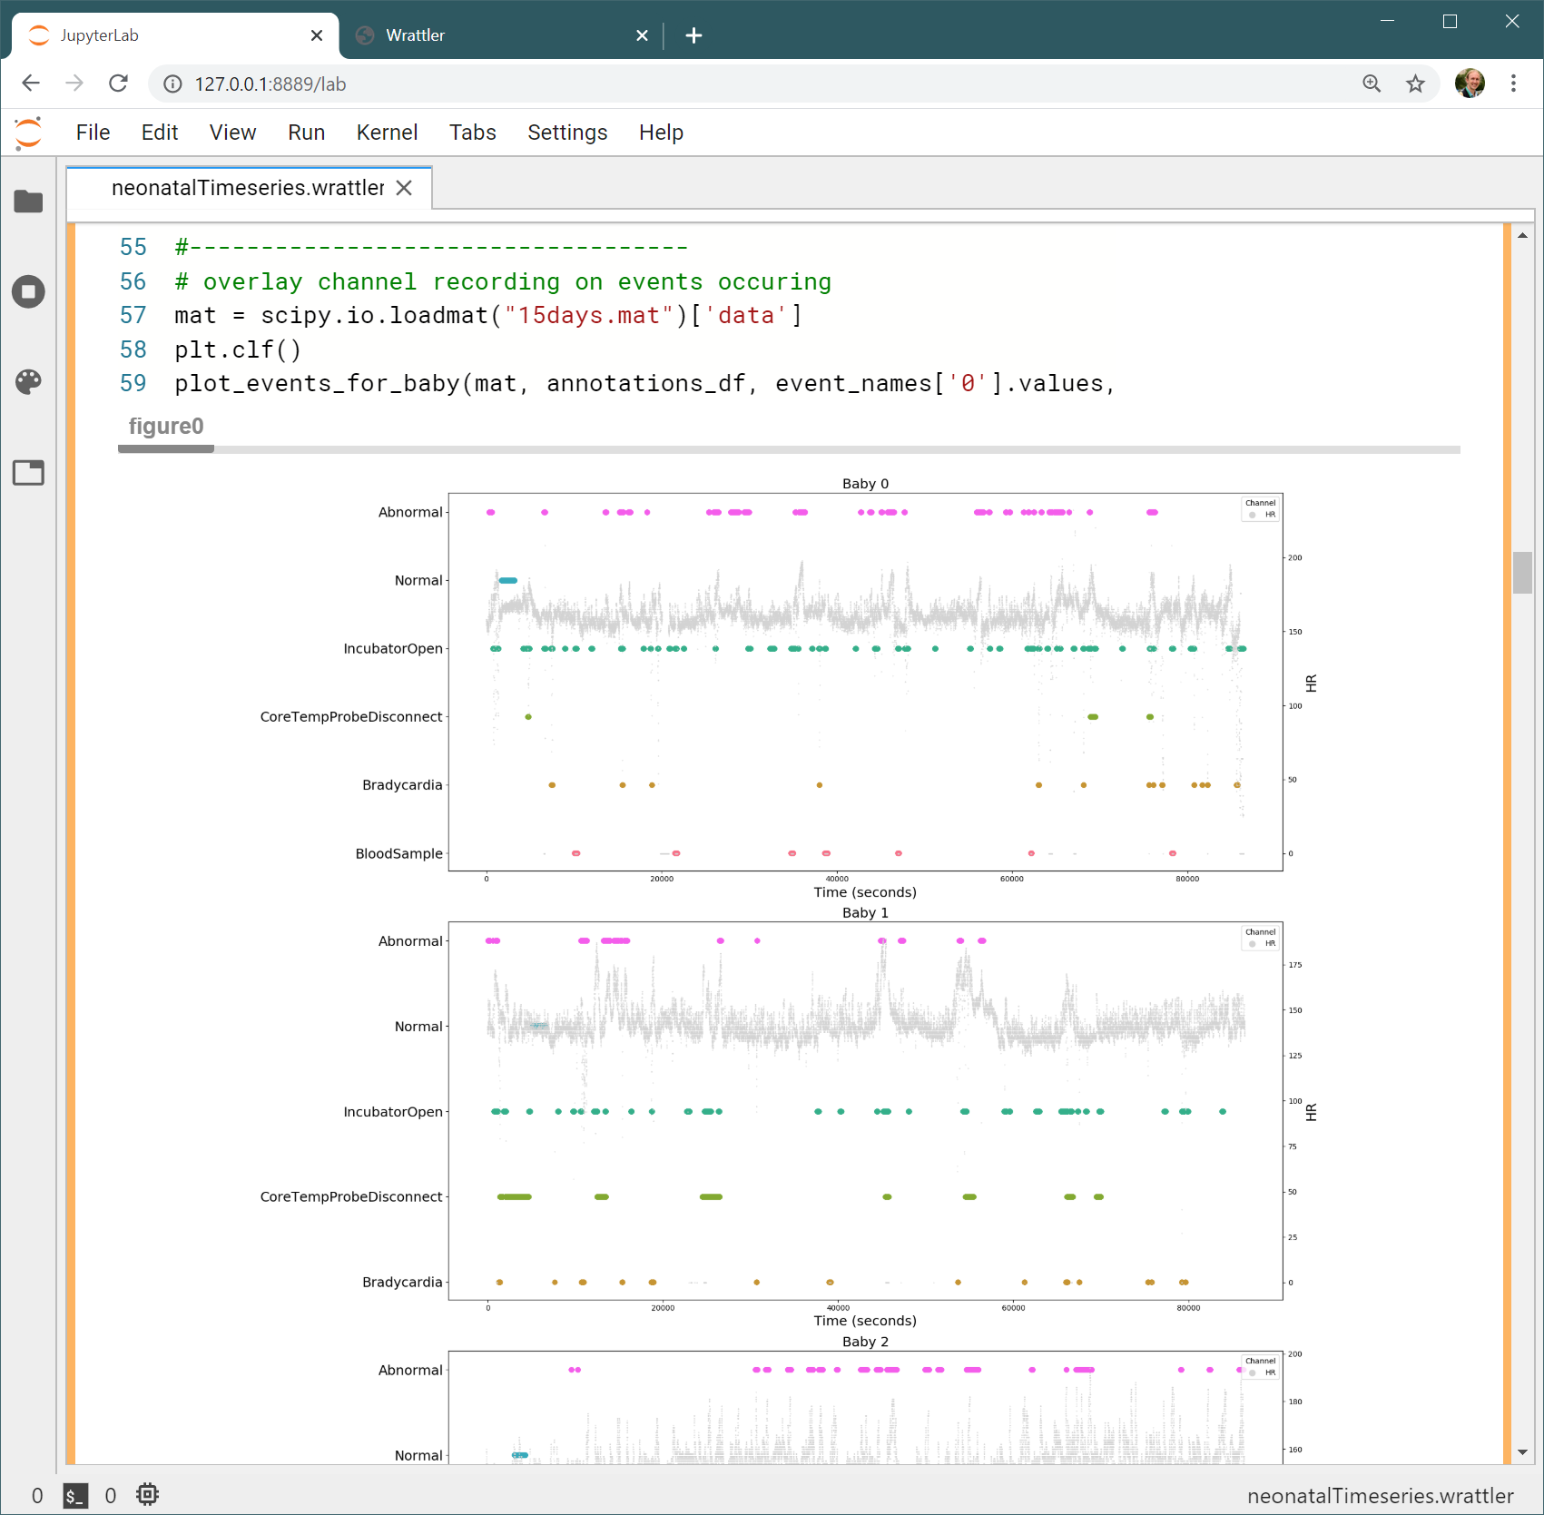
Case study II: Detecting patterns in neonatal intensive care (1a)
In this analysis, we investigate whether we can detect patterns in the monitoring traces of premature babies in intensive care. The data used consists of several physiological measurements on fifteen patients
in neonatal intensive care over 24 hours. There are several technically interesting aspects:
The analysis uses Python for data analysis and popular JavaScript D3 package for visualization.
The notebook serves tests the viability of the Wrattler system on a large and complex analysis.
This work has been done by Turing Research Engineering members Anna Hadjitofi with May Yong and our project partners. The code is available from: https://github.com/wrattler/wrattler-examples

Slide 11
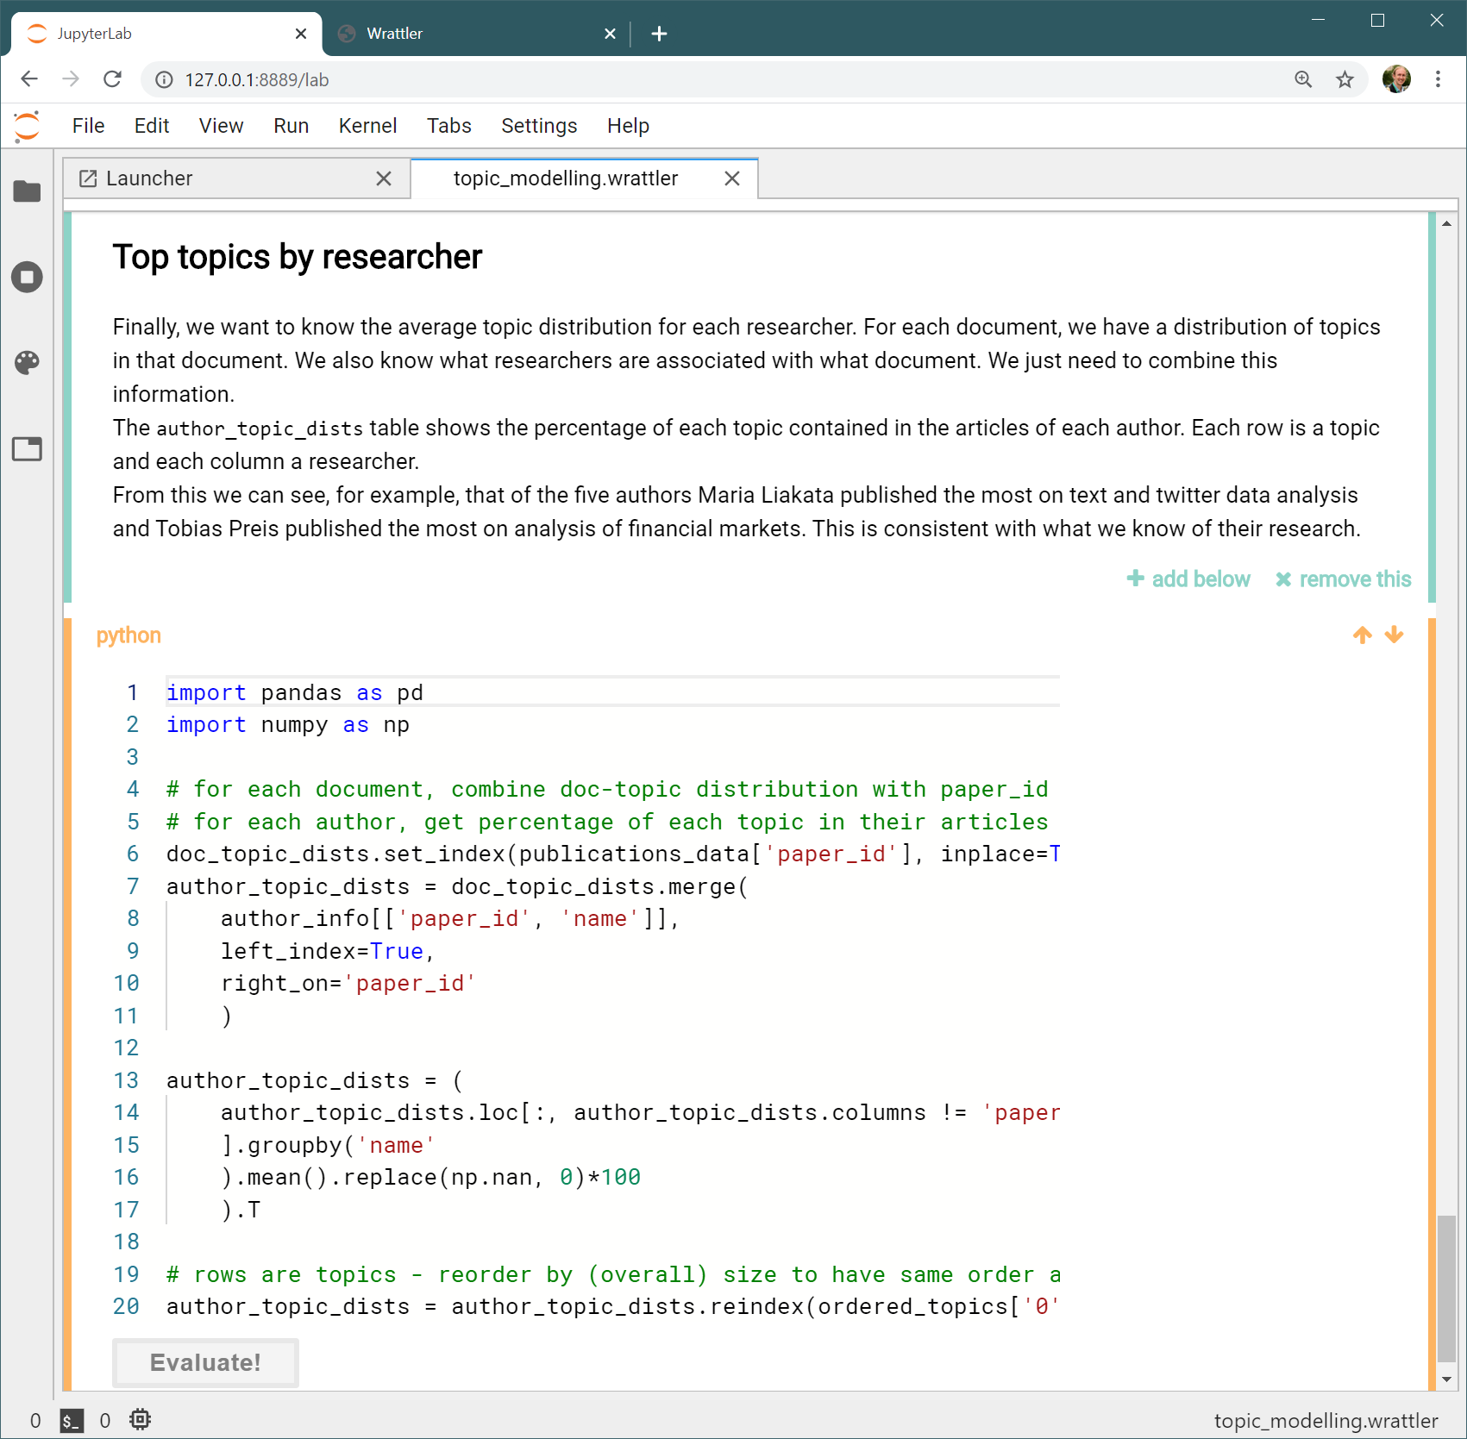
Case study III: Topic modelling of Turing publications (1a)
We adapted parts of an analysis that illustrates the breadth of topics covered by publications by Turing researchers to run in Wrattler.
The analysis uses interactive data visualization libraries in Python (pyLDAvis). To support those, we extended Wrattler with a mechanism for displaying interactive outputs produced by Python and R.
The analysis motivated two potential future projects for Wrattler: support for passing files between blocks and support for interactive data cleaning. Those were not pursued as part of this project.
This work has been done by Turing data scientist Radka Jersakova. The code is available from: https://github.com/wrattler/wrattler-examples

Slide 12
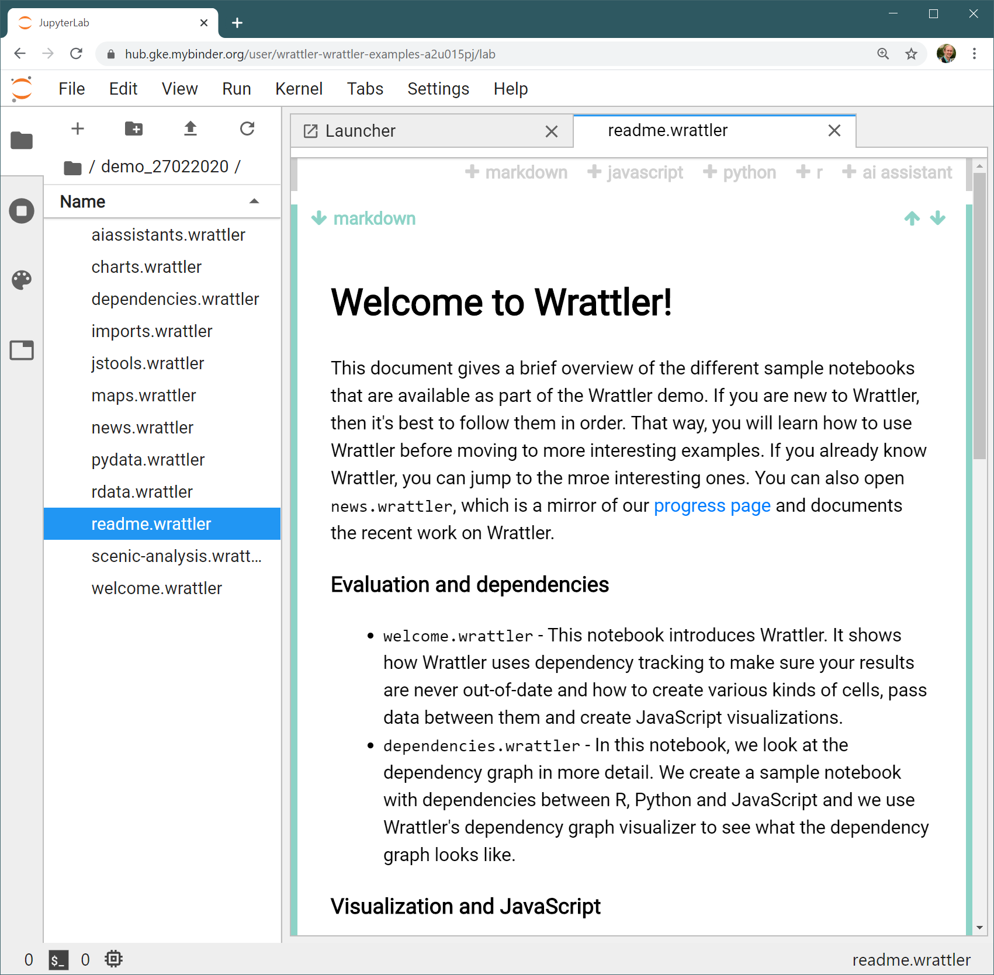
Integration with Binder and Jupyter Lab (1c)
Wrattler is now fully integrated with Jupyter Lab and Binder, which makes it a part of a growing data science ecosystem with long-term sustainability.
Binder provides an easy way to launch Wrattler in the cloud using a Kubernetes cluster. Binder Hub can be hosted on a variety of cloud providers including Google Could, AWS and Azure.
JupyterLab makes it possible to use Wrattler as part of larger data science projects, alongside existing tools such as IPython notebooks.
Using the two tools also made it possible to create “Try in BinderHub” button for the homepage which starts Wrattler directly in the web browser.

Slide 13
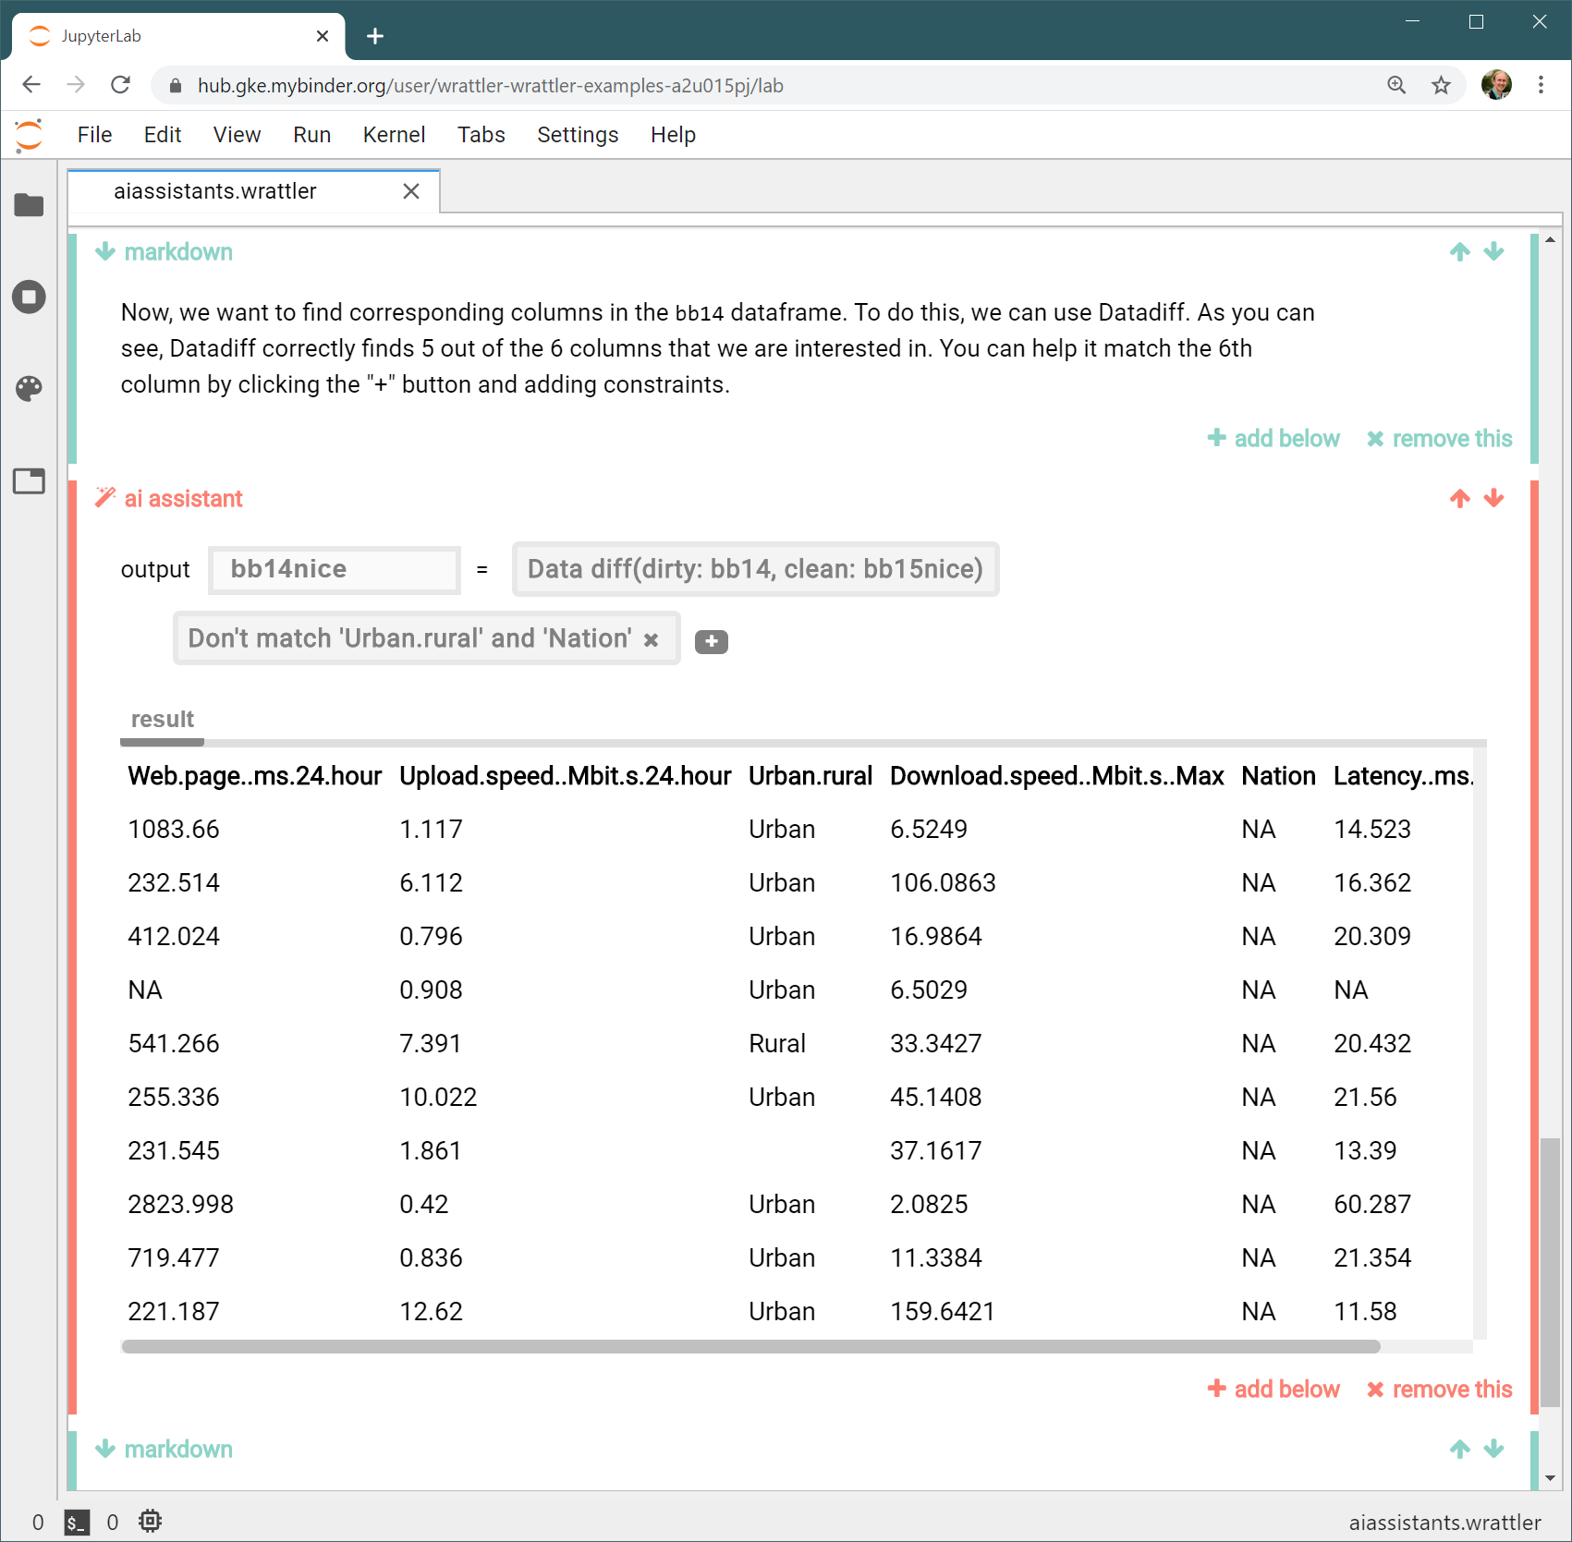
Interactive AI assistants (2a)
AI assistants are semi-automatic tools that assist the analyst when solving data wrangling challenges. We developed interactive versions of three AIDA assistants.
AI assistants are available as a new type of block. They are used through an interactive user interface: (i) the assistant attempts to find a solution, (ii) user clicks the “+” button to specify constraints and (iii) the assistant refines the previous solution (see figure).
We developed a new assistant for outlier detection and adapted three AIDA assistants (DataDiff, ptype and CleverCSV) into the new interactive framework. How to create a new assistant is documented online:
https://github.com/wrattler/wrattler/tree/master/aiassistants
The work has been done by Turing researchers Gerrit van den Burg, Alfredo Nazabal and Taha Ceritli

Slide 14
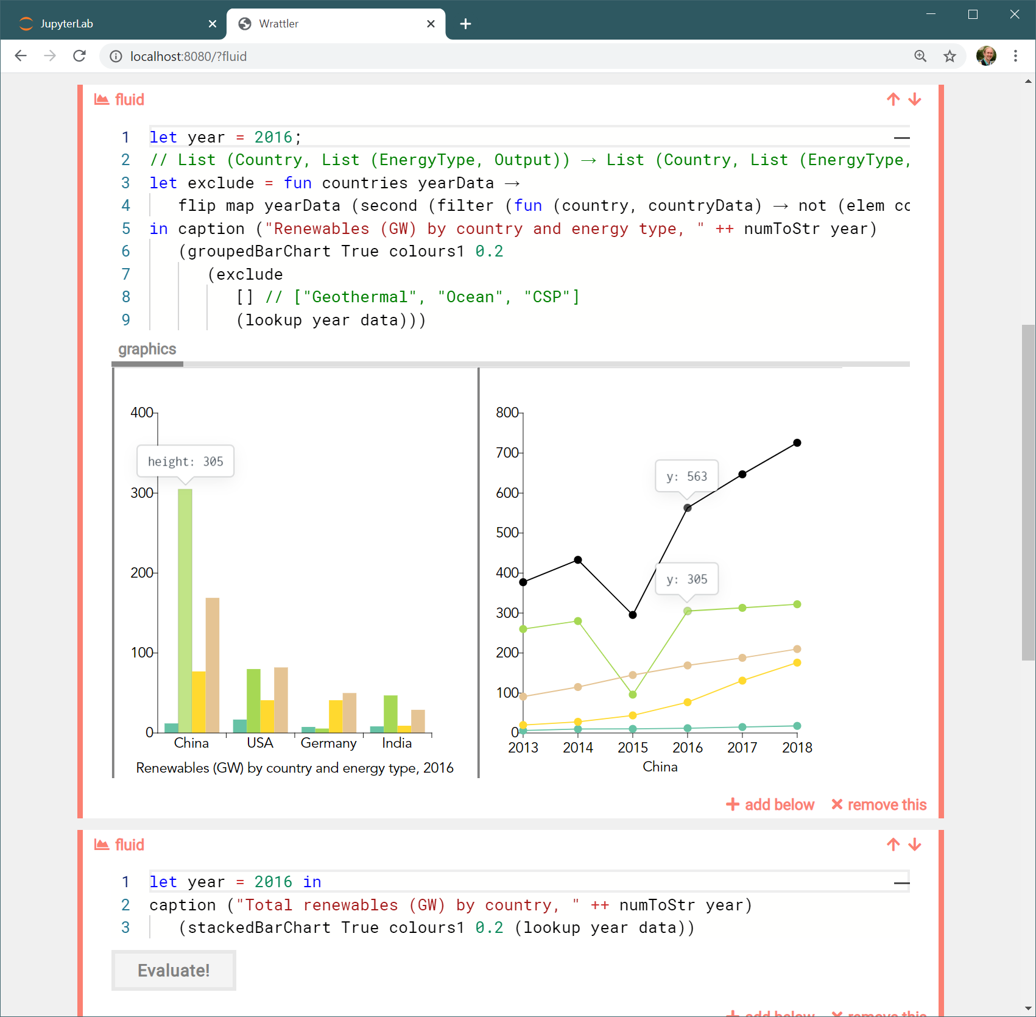
Fluid – Integration for a data visualization language (2d)
We added support for Fluid, a research programming language for building transparent data visualizations.
For example, linked charts (see figure) make it easier to see how input data contribute to different aspects of a chart by highlighting how a data point contributes to two different charts. Building linked charts is difficult and typically requires manual coding of a specific chart.
In Fluid, linking can be used with any chart created by the analyst. Fluid uses provenance tracking to understand what inputs and what code contribute to a particular visual feature of a chart and visualizes those connections.
Fluid has been developed by Roly Perera and is available at: https://github.com/rolyp/fluid

Slide 15
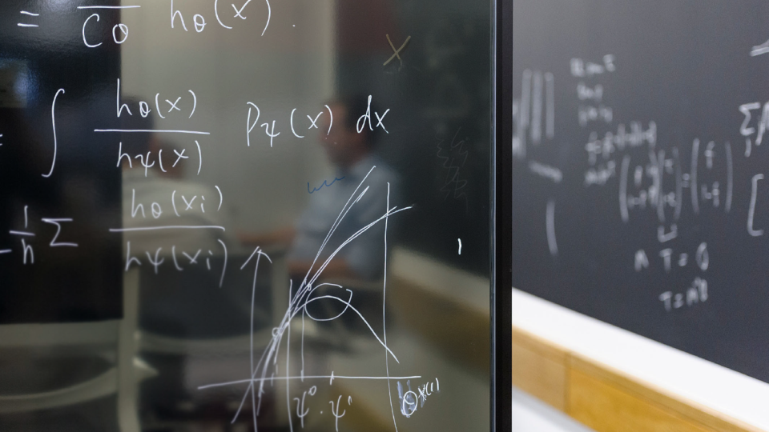
turing.ac.uk @turinginst

